Slide 1

Case study 2 Project
https://git.fhict.nl/I495166/case-study-2-project-group-10
Francisco marco sava vasilev kaloyan andreev
f.marco@student.fontys.nl s.vasilev@student.fontys.nl k.andreev@student.fontys.nl
https://git.fhict.nl/I480437 https://git.fhict.nl/I495166 https://git.fhict.nl/I476236

Slide 2

AGENDA
Project definition
Architecture
Security
Demo
Conclusion

Slide 3

Project definition

Slide 4
Project definition – introduction
Develop a platform for users to upload and store their files remotely.
Allow users to synchronize folders between different devices.
Google Drive, Dropbox, OneDrive, etc.
Users connect to a web-application, register an account, and get access to the service.
VPN connection required

Slide 5




Project definition – Functional requirements
Upload, delete and download your files
Manage and view your files
Reduce storage costs by storing your files remotely
Synchronize files between two machines

Slide 6




Project definition – non-Functional requirements
Security
Scalability
Usability
Portability

Slide 7
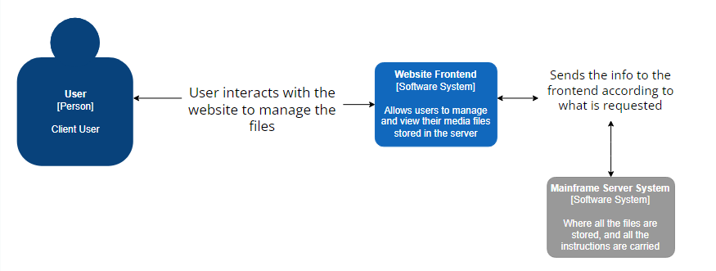
Project definition – c4 model

Slide 8
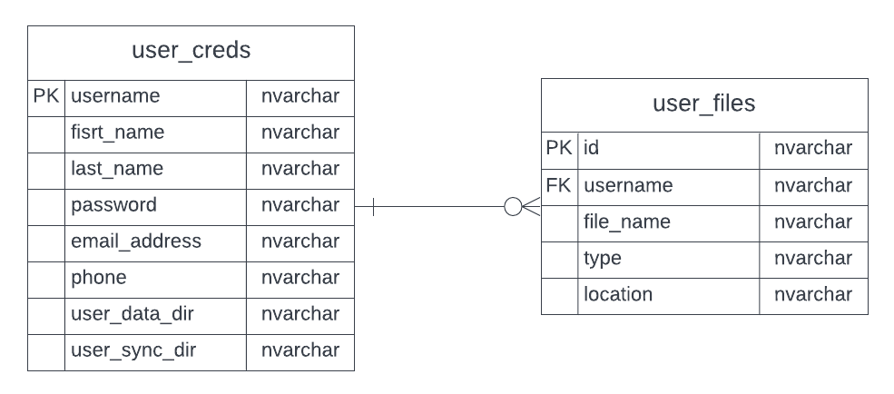
Project definition – erd

Slide 9
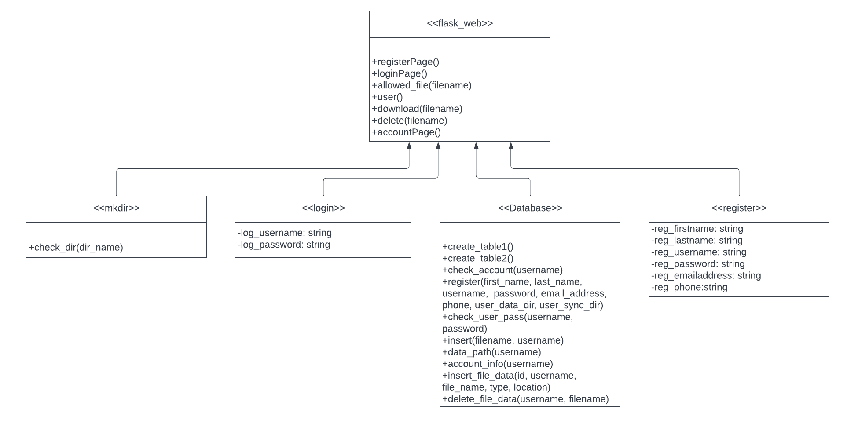
Project definition – uml

Slide 10
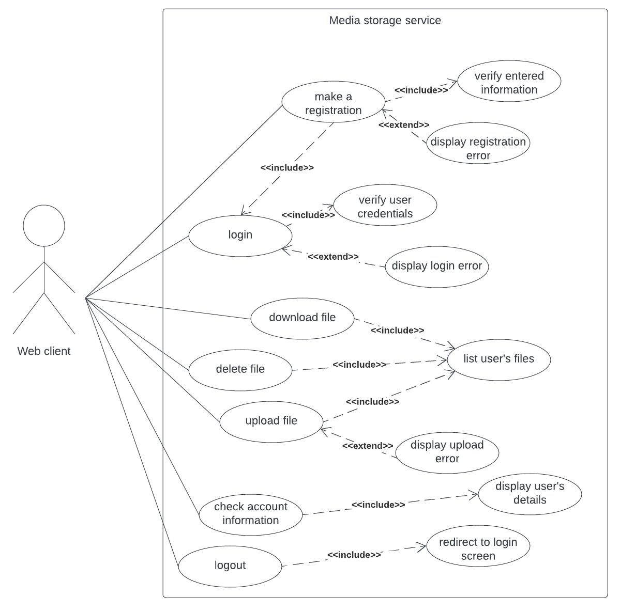
Project definition – Use case diagram

Slide 11
architecture

Slide 12
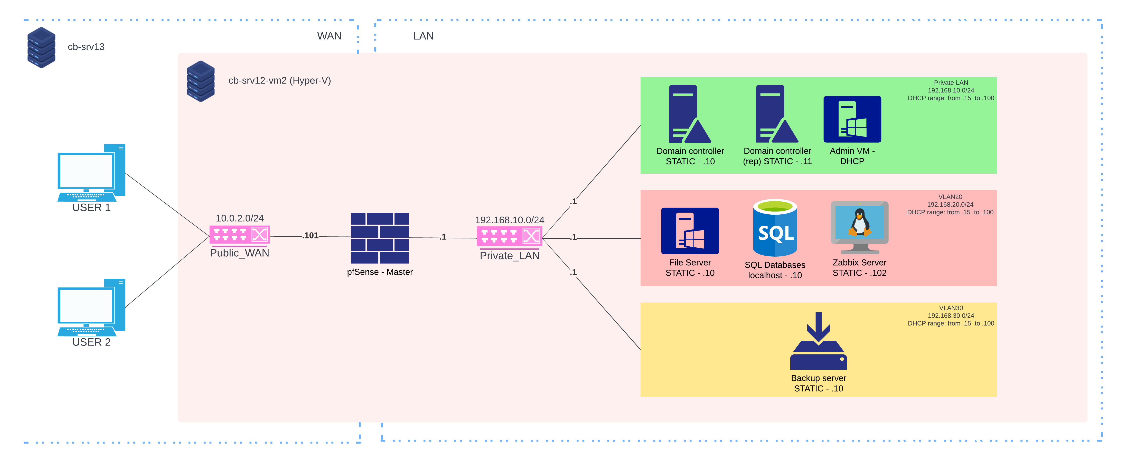
Architecture – network diagram

Slide 13
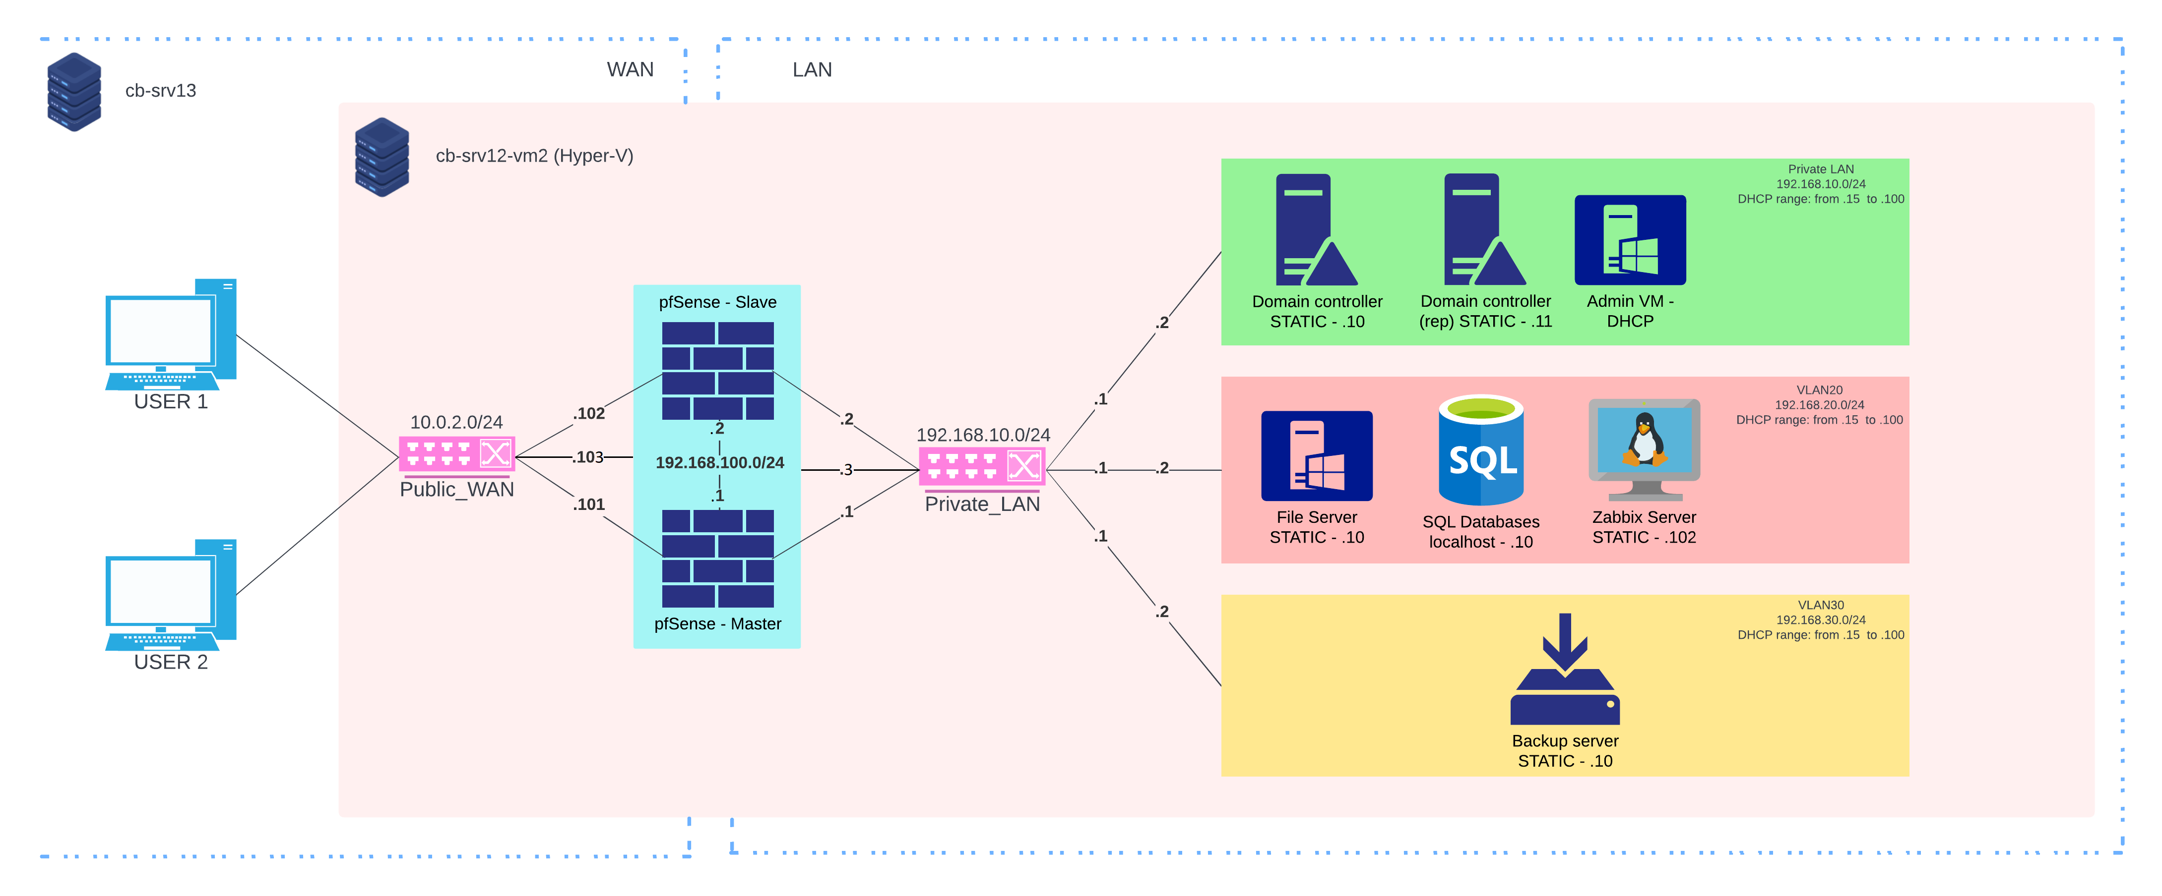
Architecture – Design for failure

Slide 14




Architecture – features
Monitoring
IDS/IPS
Database
Active Directory

Slide 15
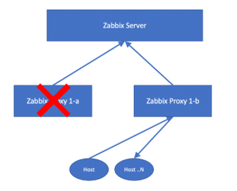
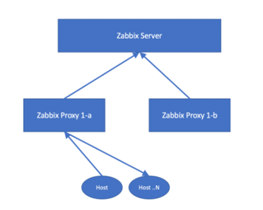

Architecture – High Availability & REDUNDANCY
Zabbix
Domain Controller(s)

Slide 16
security

Slide 17
Security – backups
Host-based backup
Agent-based backup
Once week
Backup of File Server
Backup to C:\Backups
Encrypted
Every day – 23:59
BRM backup of File Server
Backup to Backup Server
Encrypted

Slide 18


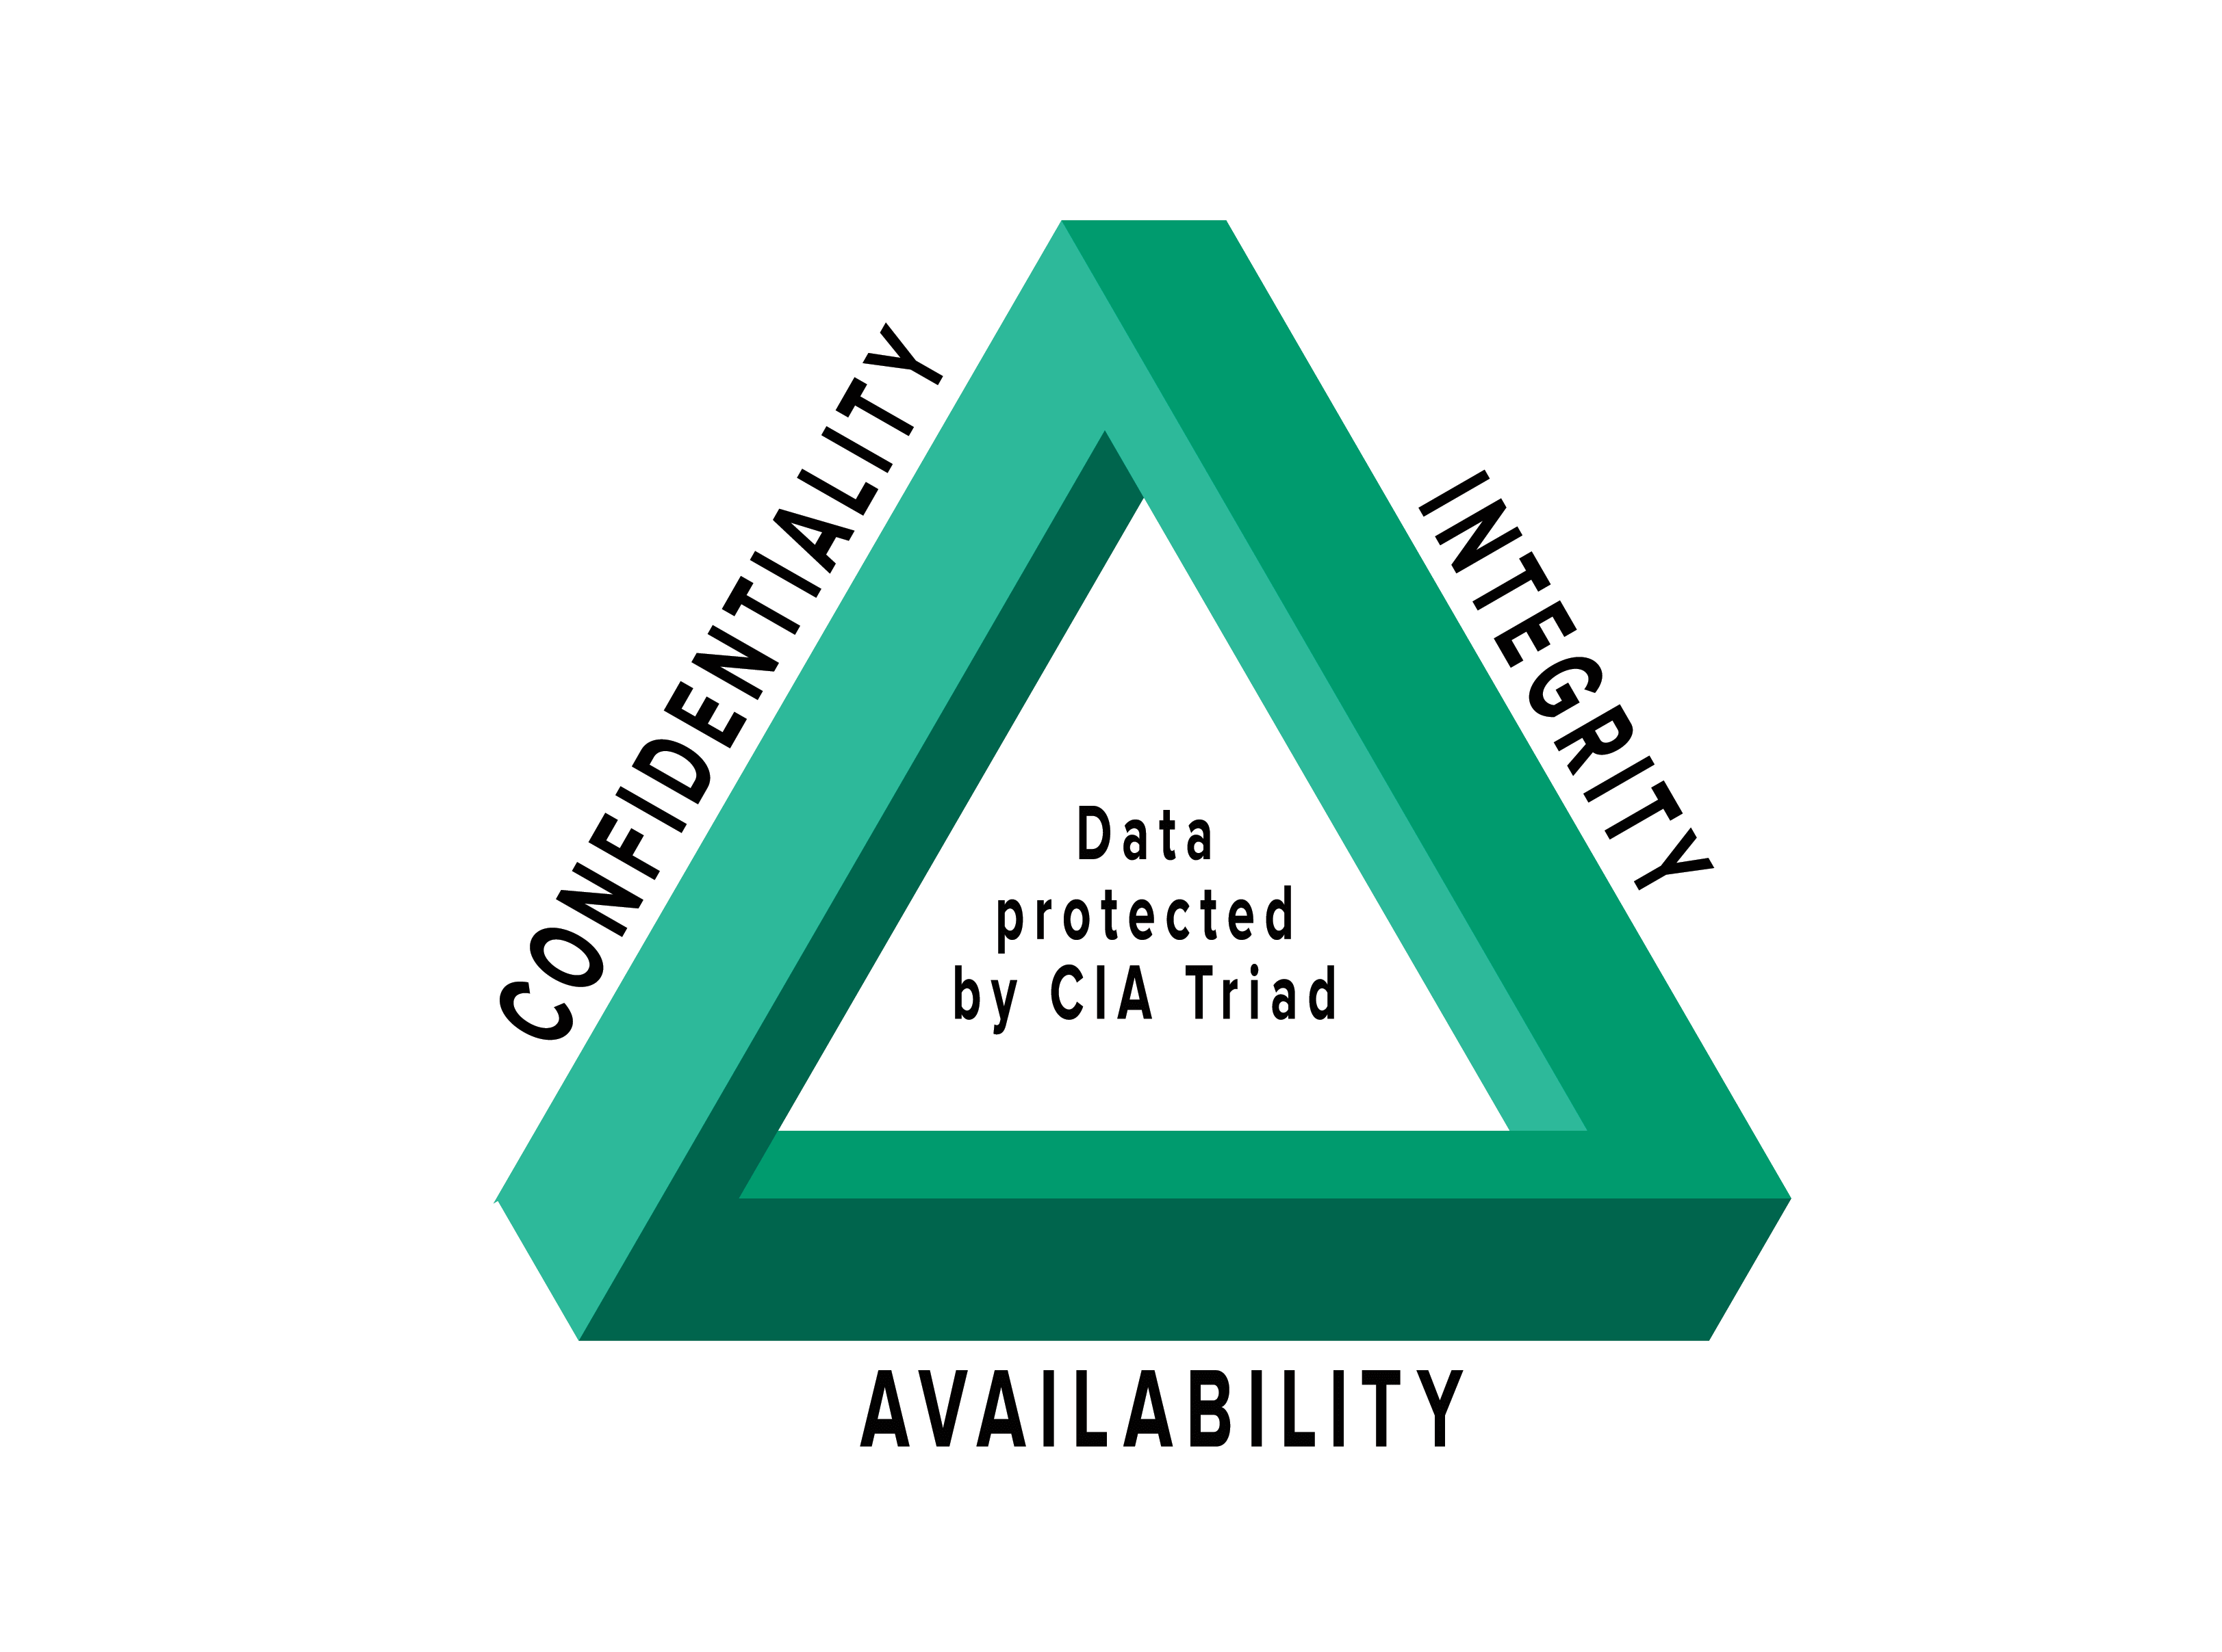

Security – measures
VLANs
High Availability
Encryption
CIA complaint

Slide 19
Security – GDPR
Data Processing
User’s Individual Rights
Username
Name
Password
Email address
Phone number
Uploaded Files
Be informed including privacy information
Request personal data
Rectification and data quality
Erasure including retention and disposal
Restrict Processing
Right to object

Slide 20
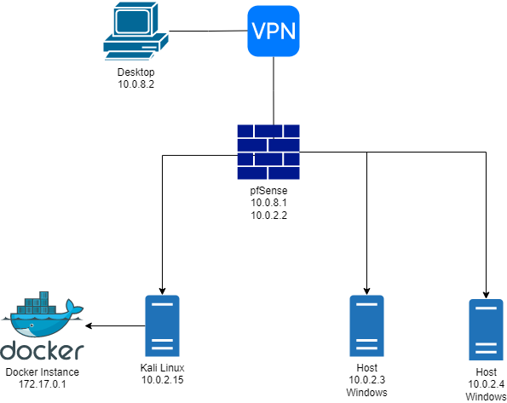
Security – pen-testing
Reconnaissance
Network Discovery:
Netdiscover
Nmap
LEGION
Zenmap

Slide 21
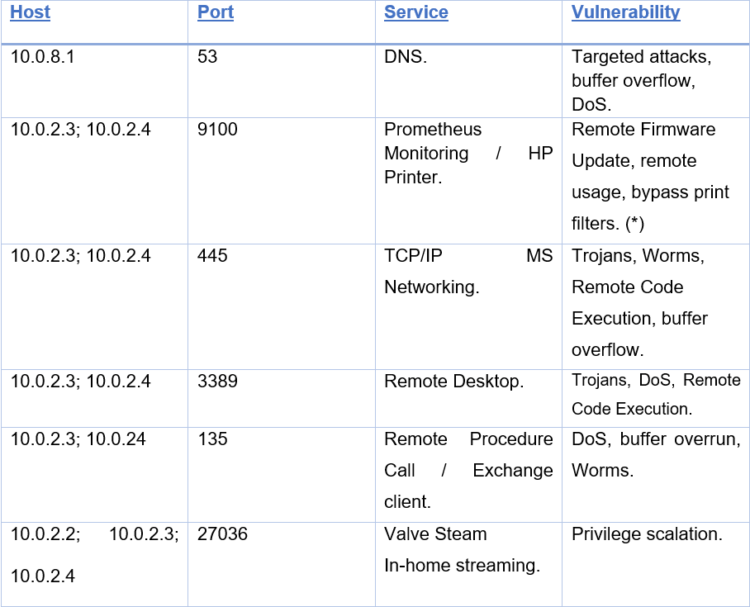
Security – pen-testing
Vulnerability Analysis
Malware (Trojans, Worms)
DoS
RCE

Slide 22
DEMO

Slide 23
conclusion

Slide 24

Thank you
https://git.fhict.nl/I495166/case-study-2-project-group-10

